Slide 1
FARM: Crop Yield Prediction via Regression on Prithvi's Encoder for Satellite Sensing
Paper review — Nejadshamsi et al. Fine-tuning a geospatial foundation model for intra-field canola yield mapping

Slide 2
Paper at a glance
R² 0.81
208 kg/ha
30 m
600 M
Pixel-level canola yield variance explained (val set)
Best RMSE (de-standardized)
Output resolution — intra-field pixel maps
Parameters in Prithvi-EO-2.0 encoder
WHAT IT IS
FARM (Fine-tuning Agricultural Regression Models) adapts IBM/NASA's Prithvi-EO-2.0-600M Vision Transformer for a continuous pixel-level regression task, producing 30 m intra-field canola yield maps over the Canadian Prairies — bridging large-scale Earth-observation foundation models and on-farm decision-making.

Slide 3
Introduction — the gap FARM addresses
Why this problem matters
Four gaps in prior work
Yield forecasts underpin food security, government planning and farmer risk management.
Field surveys and process-based crop models are costly and don't scale across regions.
Sentinel-2 / Landsat EO now deliver continuous, high-quality crop observations.
CNN/RNN models capture nonlinear patterns but are trained on small task-specific sets.
ViTs & geospatial foundation models (Prithvi-EO) now expose transferable Earth-system priors.
1. Trained from scratch on small agri datasets — forgo Earth-system priors.
2. County-level only useful regionally, blind to intra-field heterogeneity.
3. Framed as classification discrete bins lose continuous yield signal.
4. Black-box predictions no insight into which growth stages or bands drive them.

Slide 4
Methodology — Data
Source
Bands × time
Chip tensor
Labels
Sentinel-2 (HLS), Canadian Prairies 2018, 2019, 2020, 2022, 2023
6 bands × 5 monthly composites (May → Sep) Cloud filter < 10%
[30 × 224 × 224] (C·T flattened) → ViT patch embed
30 m pixel maps upsampled from county-level yield (bilinear)
Splits & spectral spec
Independent high-res validation set
6079 training image chips, 1749 validation (temporal hold-out)
Bands: Blue, Green, Red, NIR-Narrow, SWIR 1, SWIR 2
Normalization: channel-wise mean / std from train set
Augmentation: H/V flips p=0.2; Gaussian noise p=0.4
Native 10 m yield-monitor labels, multiple Prairie fields, 2013–2024
Never seen at training time — held out as external test set
Same Sentinel-2 HLS inputs; only labels differ from main set
Inputs upsampled 10 m → 5 m to match 224-px FARM checkpoint

Slide 5
Methodology — FARM architecture
Input tensor
Prithvi-EO encoder
UperNet decoder
Regression head
Yield map
[B, 30, 224, 224] 6 bands × 5 months
ViT, 32 blocks 14×14 patches + spatio-temporal embeddings
FPN + PSP fuses layers 8 / 16 / 24 / 32
3 × 3 × 3 convs + BN + ReLU → 1 channel
[B, 1, H, W] per-pixel kg/ha 30 m resolution
Key design choices
Encoder is unfrozen — all 600 M Prithvi weights fine-tuned end-to-end on canola data
Time as channel: 5 monthly composites × 6 bands flattened into 30 input channels; ViT self-attention models space+time jointly
Multi-scale fusion: UperNet pulls encoder layers 8/16/24/32 to reconstruct dense maps from abstract ViT tokens
Deep supervision: auxiliary regression head adds 0.2 × Laux to total loss → stabilizes training of the deep network

Slide 6
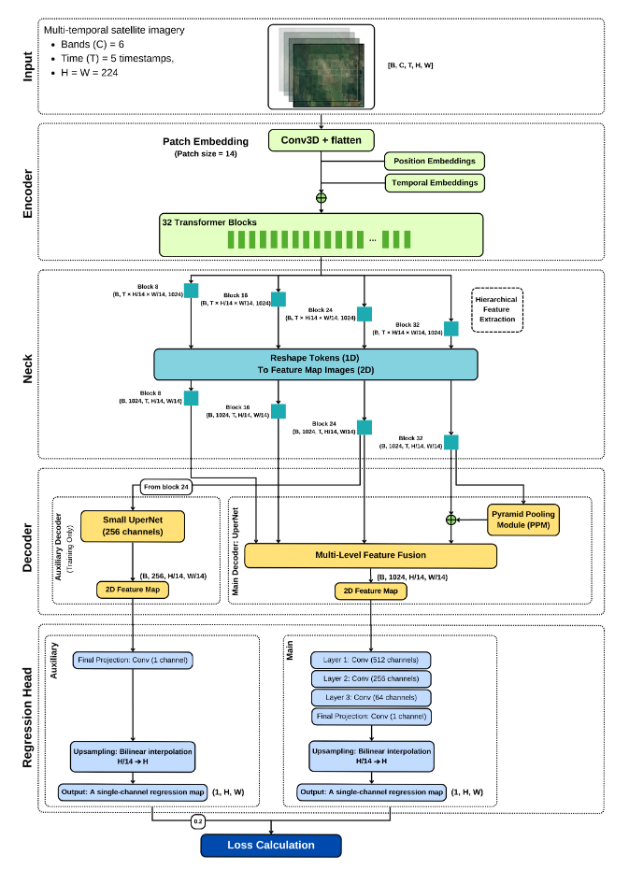
Methodology — FARM architecture
Key design choices
Encoder is unfrozen — all 600 M Prithvi weights fine-tuned end-to-end on canola data
Time as channel: 5 monthly composites × 6 bands flattened into 30 input channels; ViT self-attention models space+time jointly
Multi-scale fusion: UperNet pulls encoder layers 8/16/24/32 to reconstruct dense maps from abstract ViT tokens
Deep supervision: auxiliary regression head adds 0.2 × Laux to total loss → stabilizes training of the deep network

Slide 7
Training objective & evaluation
Loss function
Training setup
Evaluation & baselines
Primary: per-pixel MSE on standardized yield
Robust variant: Huber loss for outlier sensitivity
Deep supervision: aux UperNet head with weight 0.2
Total = L_main + 0.2 · L_aux
PyTorch 2.6 + Lightning, seed 0
AdamW weight decay 0.1
LR 5e-6 → 1e-8, cosine + 20-epoch warm-up
120 epochs, batch 8, bfloat16
Hardware: NVIDIA 48 GB GPU node
Metrics: RMSE, MAE, R², Pearson r
Validation: temporal hold-out on unseen seasons
Baselines: 3D-CNN and DeepYield, retrained from scratch on the same canola data
Reported in standardized units + kg/ha + bu/ac

Slide 8
Results — FARM vs. baselines on the validation set
Best-configured FARM (MSE + Aux head)
RMSE
0.437 std · 209 kg/ha · 3.73 bu/ac
MAE
0.332 std · 158 kg/ha · 2.83 bu/ac
R²
0.811
Pearson r
0.900
FARM cuts RMSE by ~58% vs. DeepYield and lifts R² by 7.8 pts. Pearson 0.90 indicates predicted yields track the ground-truth trend almost linearly.

Slide 9
Transfer learning works — and the model learns agronomy
Validation on independent 10 m yield-monitor data
Interpretability — what the model attends to
Canadian Prairies, 2013–2024 — never seen in training
Temporal attention
Zero-shot
R² 0.508 · RMSE 0.921
Fine-tune on high-res
R² 0.768 · RMSE 0.628
May
Jun
Jul
Aug
Sep
Peaks in July (flowering & pod-fill) — agronomically the right window
From scratch on high-res
R² 0.675 · RMSE 0.557
Spectral band importance
NIR-Narrow
SWIR-1
Fine-tuning the county-level pre-trained FARM beats training from scratch on the same scarce high-res data — confirms the transfer-learning hypothesis.
SWIR-2
Red
Green
Blue

Slide 10
Limitations & proposed solutions
LIMITATION
PROPOSED PATH FORWARD
Single crop, single region
Multi-crop fine-tuning
Trained & validated on canola in the Canadian Prairies only.
Adapt to wheat first; test whether shared geospatial representations transfer across phenologies.
Imagery-only inputs
Multi-modal fusion
No meteorological or soil data alongside HLS multi-temporal imagery.
Inject weather time-series and soil property layers as auxiliary input branches.
Sparse high-resolution ground truth
Continue transfer-learning pipeline
From-scratch model (R² 0.68) underperformed fine-tuned (R² 0.77) — data-limited.
Use upsampled county-level data as a foundation; periodically refresh with new yield-monitor harvests.
No uncertainty estimates
Add uncertainty quantification
Predictions are point values — limits trust in automated VRA decisions.
Heteroscedastic regression head or MC-dropout to emit per-pixel confidence intervals.
Not yet deployment-ready
FMIS / VRA integration + faster pipeline
HLS-to-inference latency and no FMIS integration limit in-season use.
Stream predictions into Farm Management Information Systems as a VRA prescription layer; shorten satellite-to-inference latency.

Slide 11
CONCLUSION
Foundation models bring Earth-observation context to precision agriculture.
01
02
03
Pre-training beats from-scratch
Continuous, pixel-level outputs
Agronomically interpretable
Fine-tuning Prithvi-EO-2.0 outperforms 3D-CNN, DeepYield, and the same architecture trained from scratch on scarce high-res labels.
Treating yield as regression (not classification) preserves intra-field heterogeneity — the signal precision agriculture needs.
Attention concentrates on the flowering / pod-fill window and on NIR + SWIR bands — matching established crop physiology.
Nejadshamsi, Zhang, Porth, Zaki, Porth & Khoshdel — AgriEngineering 2026, 8(1), 2

Slide 12
Thank You!

